Slide 1
Module 2 Greedy method

Slide 2
Introduction….
Straight forward design technique
Can apply to wide variety of problems
All problems have n inputs
Need to obtain a subset that satisfies some constraints
Any subset that satisfies these constraints→ feasible solution
Need to find feasible solution that either maximizes or minimizes given objective function→ optimal solution

Slide 3
Cont…
In Greedy method –can devise algorithm in stages
Consider one input at a time
Each stage- decision made
Whether particular input is an optimal solution
Inputs considered by some selection procedure
If inclusion of next input to partially constructed optimal solution result infeasible solution, input not added to partial solution

Slide 4

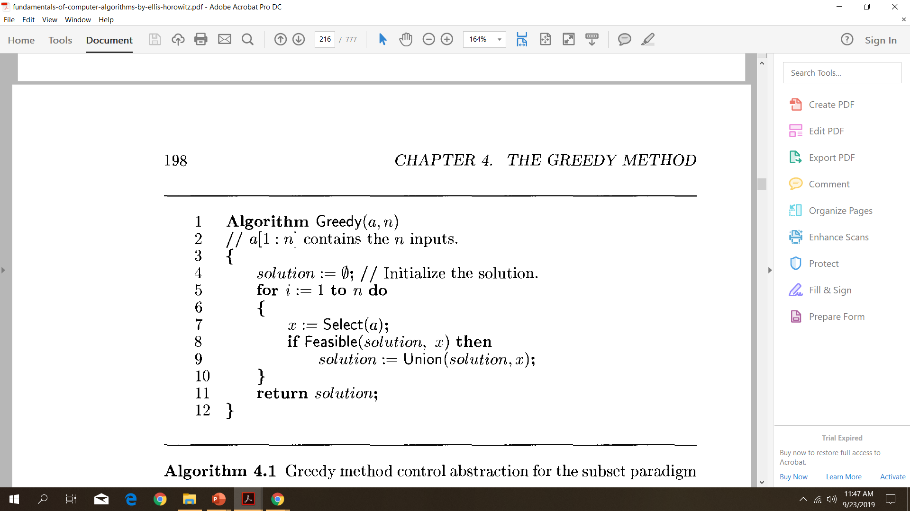
Greedy method control abstraction for the subset paradigm

Slide 5
CONT….
Select→selects input from a[] and removes it
Selected input assigned to x
Feasible→ boolean valued function, determine x Included into solution vector
Union → combine x with solution, update objective function
Once problem is chosen, functions Select,Feasible,Union are properly implemented

Slide 6
Fractional Knapsack problem

Slide 7
Can apply greedy method to solve knapsack problem
Given n objects, and a knapsack or bag.
Object i has weight Wi and profit Pi
Capacity of knapsack is m
If fraction Xi , 0<=Xi<=1, Of object i is placed in to the knapsack , a profit Pi Xi is earned
Objective→ fill knapsack that maximizes total profit earned
Capacity of knapsackis m,so total weight of all chosen objects,atmost m.

Slide 8
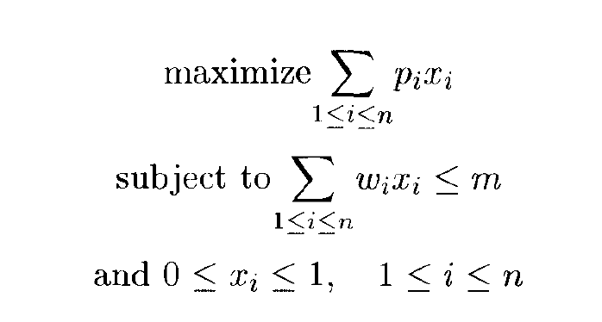
Eq 1
Eq 2
Eq 3

Slide 9
Profit & weights are positive numbers
Feasible solution(or filling) is any set(X1,X2,…..Xn) satisfying eq 2 and eq 3
Optimal solution is feasible solution that maximises eq 1

Slide 10
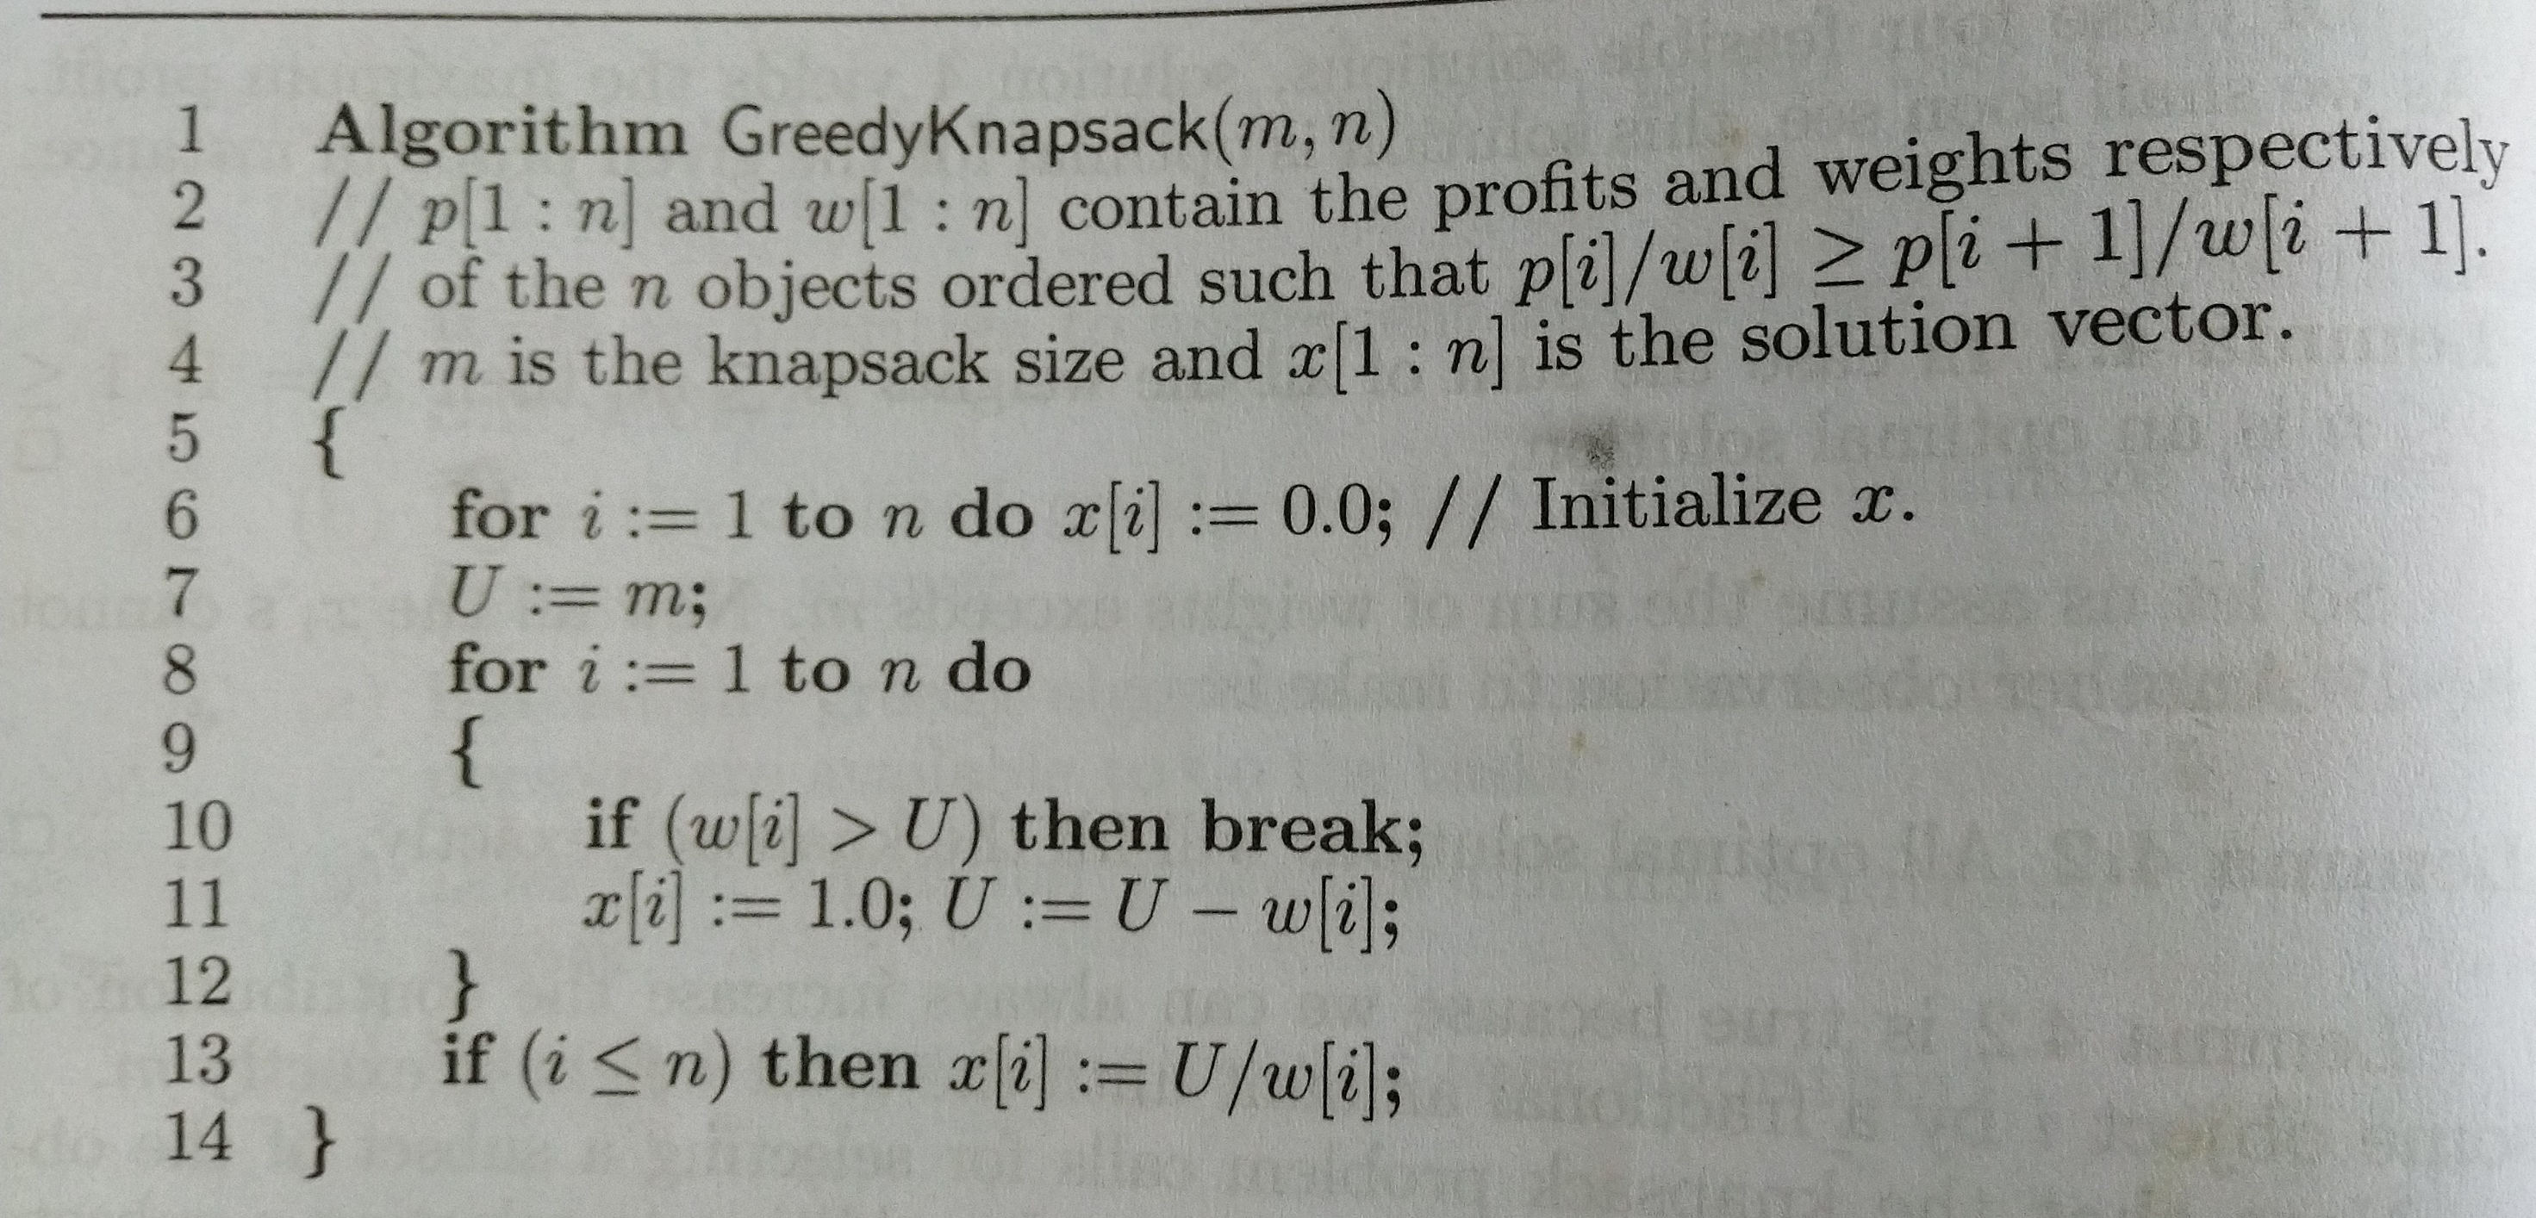

Slide 11
Example
Consider the following instance of the knapsack problem:
n = 3, m= 20, (p1,p2,p3)=(25,24,15) and, (w1,w2,w3)= (18,15,10)

Slide 12

Step 1- Calculate Pi/Wi for i=1,2,3
Step 2 – arrange the objects based on decreasing order of Pi/Wi
Step 3 –take the objects based on the order in step 2 and do the specified calculations as described in the algorithm

Slide 13
P1/w1=25/18=1.39
P2/w2=24/15=1.6
P3/w3=15/10=1.5
Order of selection (P2,P3,P1)

Slide 14
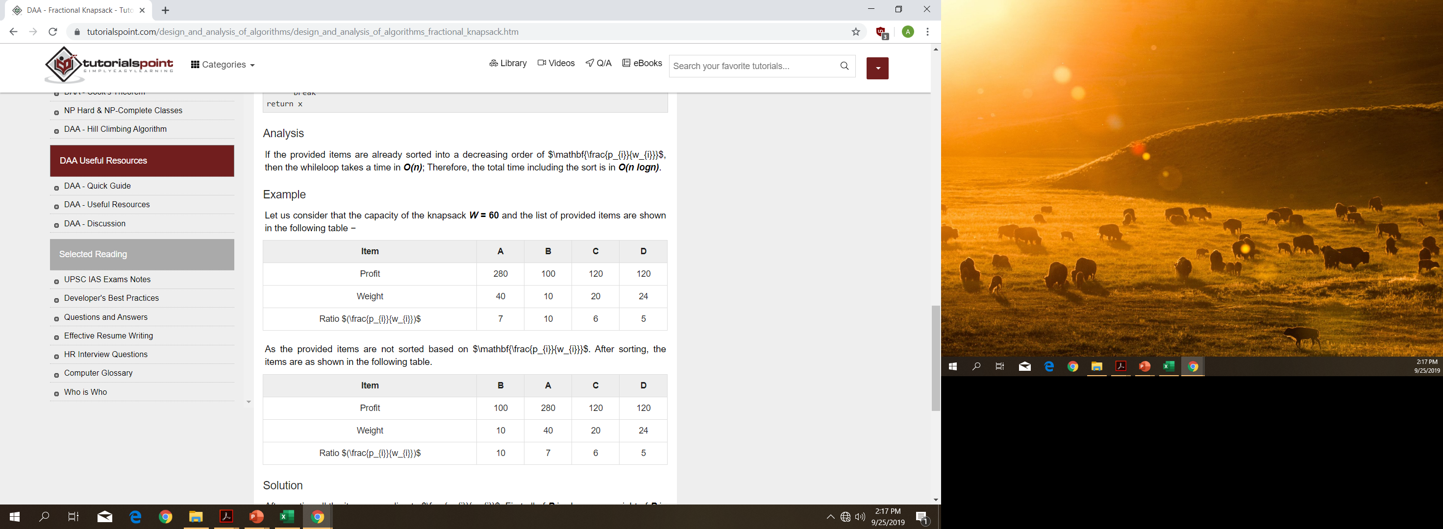
W = 60

Slide 15
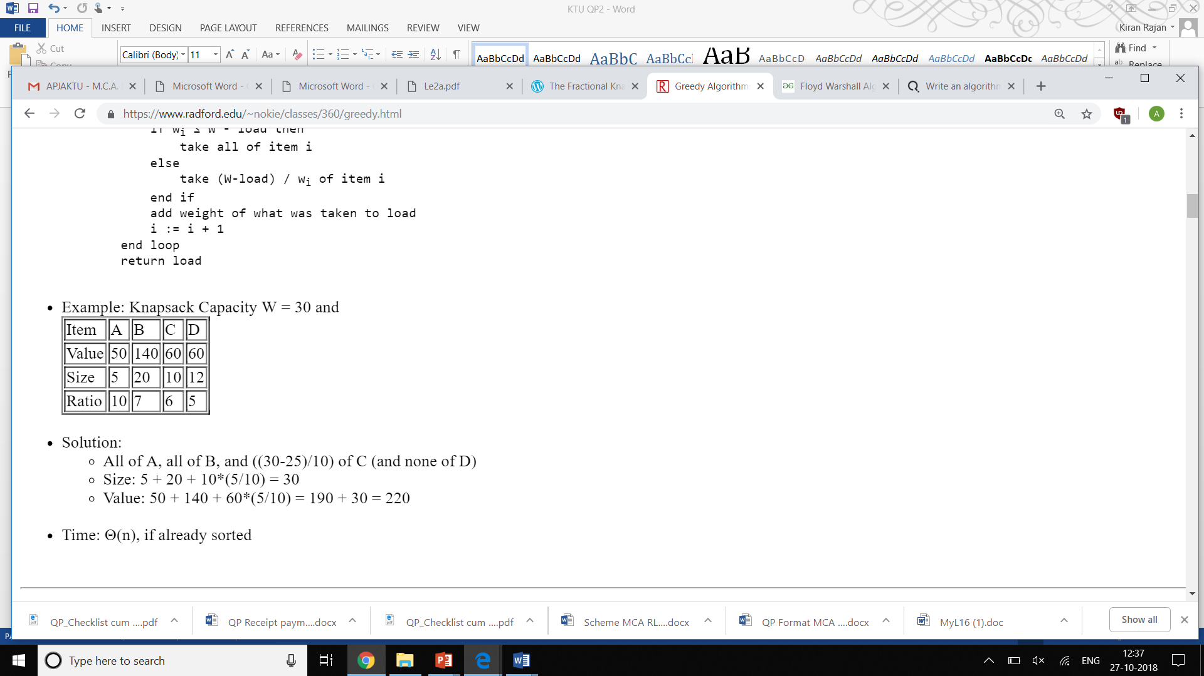
Solve the following Fractional Knapsack problem

Slide 16
Solution:
All of A, all of B, and ((30-25)/10) of C (and none of D)
Size: 5 + 20 + 10*(5/10) = 30
Value: 50 + 140 + 60*(5/10) = 190 + 30 = 220

